Slide 1
Simple Image Processing and Object Detection using Matlab
Akshar Prabhu Desai

Slide 2
Objectives
A quick introduction to matlab
Color models and their representation in matlab
Generating and analyzing histograms
Noise reduction
Detecting objects of interest in image
A graded lab assignment at the end
Download links given at the end

Slide 3
The Setup
A webcam connected to your Windows machine
Matlab R2009a
A table tennis ball
Chart paper of different colors

Slide 4
Matlab Introduction
MATrix LABolatory
The basic data type is a matrix
Basic features
Arithmetic and logical operations
Plotting
Signal Processing

Slide 5
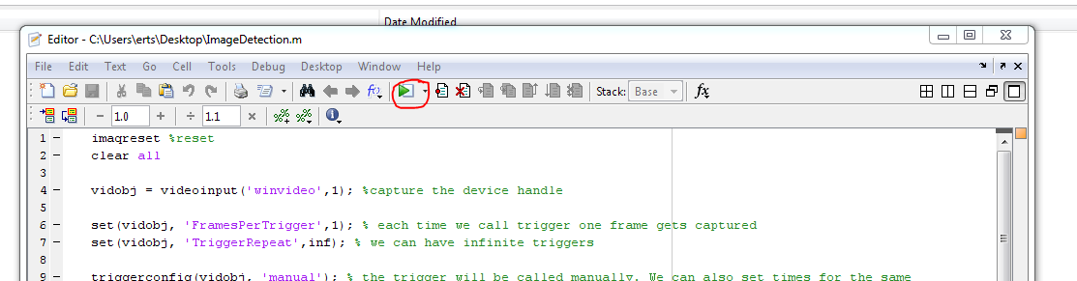
Getting Started
Create a File with name First.m
Open Matlab and Select File > open and select this file
To run a file click on the run icon

Slide 6
Defining matrix
>> d=[11 12 13 ; 21 22 23 ; 31 32 33]
This is a 2D matrix
Functions can be applied to the matrix
>> determin= det(b) ; %determinant
>> I = inv(b); %inverse
% can be used to write comments

Slide 7
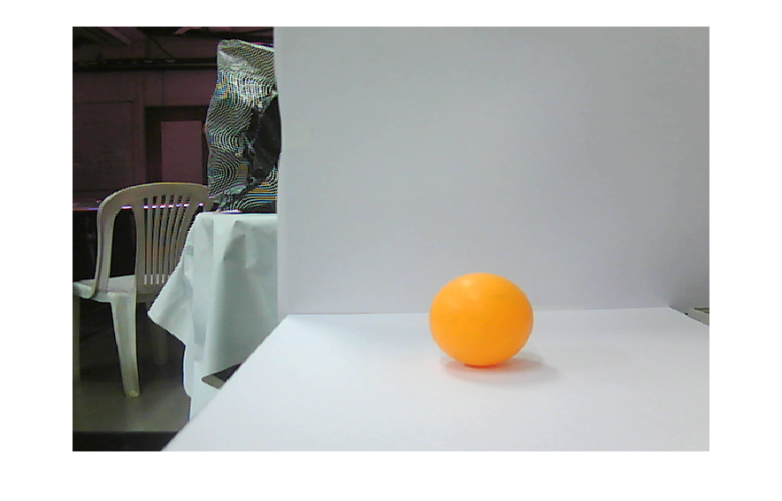
The image
This is the image we have captured using our setup. We have deliberately kept some ambience in the left hand side compared to the ideal right hand side image.

Slide 8
Capturing Images using Matlab
imaqreset %reset
clear all
vidobj = videoinput('winvideo',1); %capture the device handle
set(vidobj, 'FramesPerTrigger',1); % each time we call trigger one frame gets captured
set(vidobj, 'TriggerRepeat',inf); % we can have infinite triggers
triggerconfig(vidobj, 'manual'); % the trigger will be called manually. We can also set times for the same
start(vidobj); % start the device capture
i=1;
n=1;
% get
while 1,
trigger(vidobj); % capture one frame
frame=getdata(vidobj); % frame is a matrix that stores the frame
imshow(frame);
n = n + 1;
if(n>300),% we are capturing total of 300 frames
stop(vidobj); % never forget to close the device handle
break;
end
end
i=i+1;
Only the red code changes as we move on rest of the code remains same.

Slide 9
Color Models
RGB
CMY and CMYK
HSI
And there are more

Slide 10
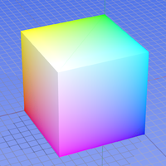
RGB model
Three primary spectral components
More suitable for Monitors
The diagonal passing through origin is the gray scale model.

Slide 11
CMY
Cyan , Magenta and Yellow
1- cyan = red (it means a cyan surface does not reflect red at all)
More suitable for printing
Guess why do we need CMYK model ? (K- is black)
CMY model is more suitable for image processing

Slide 12
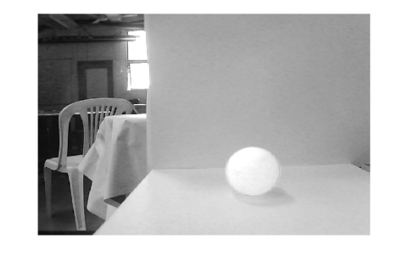
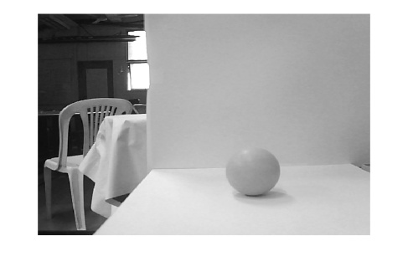
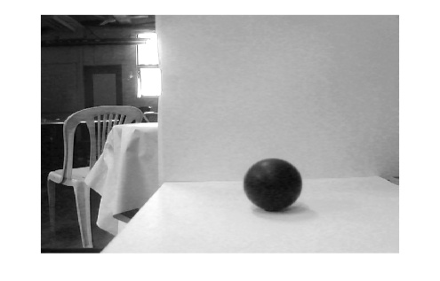
Understanding the Image Matrix
The “frame” is a 3D matrix. There are 3x2D matrixes each composed of R,G and B components.
Here are the R G B components separated and displayed
R
G
B

Slide 13
The code to display R component
while 1,
trigger(vidobj); % capture one frame
frame=getdata(vidobj); % frame is a matrix that stores the frame
imshow(frame(:,:,1)); % displaying R component, to display G and B change 1 to 2 and 3 respectively
n = n + 1;
if(n>300),% we are cpatuing total of 300 frames
stop(vidobj); % never forget to close the device handle
break;
end
end

Slide 14
Converting to Grayscale
RGB image is a 3D array we can convert it to Grayscale using the function rgb2gray.
We can build full color images from gray scale components as well.
We get a 2D array to process.

Slide 15
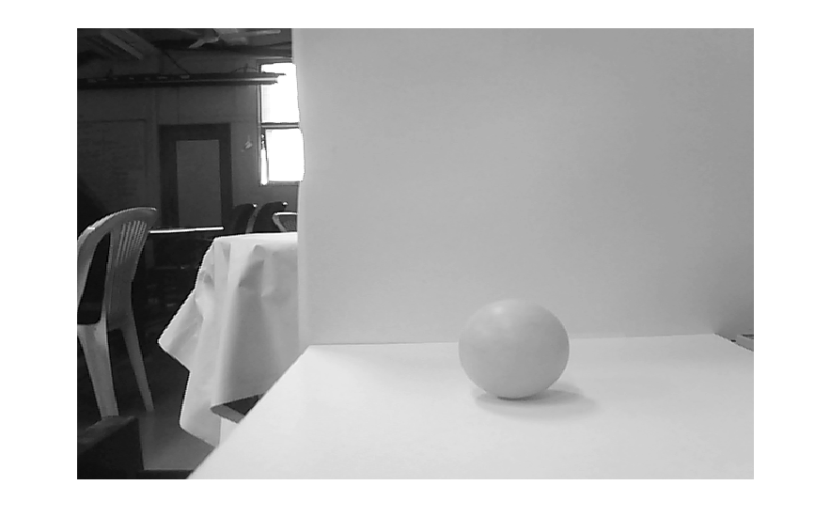
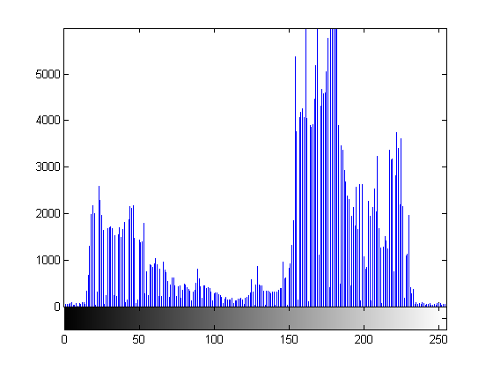
The histogram
Histogram is a plot of color and the statistical frequency of that color in the image.
imhist(im); is the command to get an histogram.

Slide 16
Why histograms matter
The object we need to detect will have a certain color.
We can detect the object by simply setting all the pixels that fall in that color’s frequency range to 1 and rest to zero.
For Example:

Slide 17
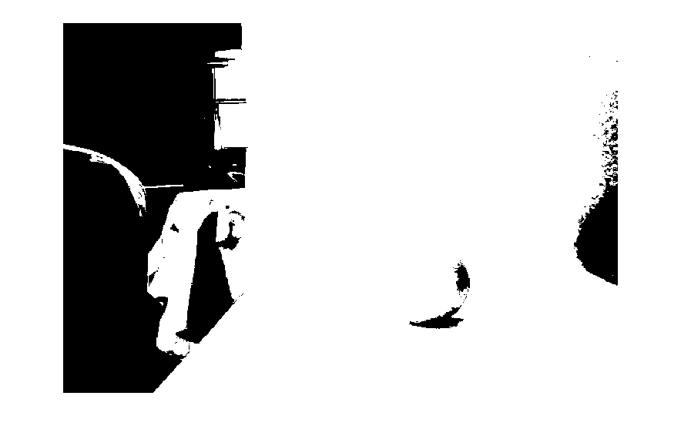
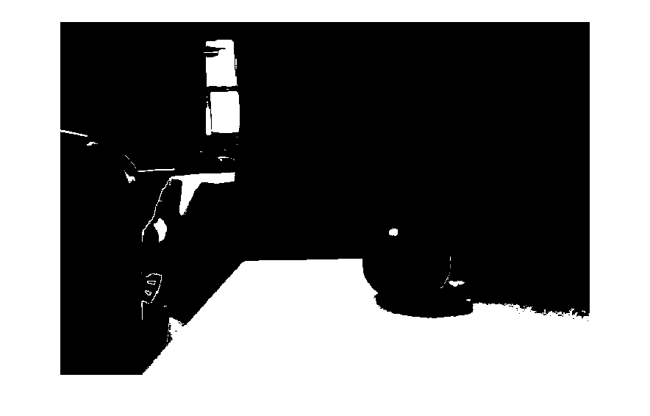
For our image
Code on next slide
Making all pixels above 200 to white rest all black.
Making all pixels above 150 to white rest all black.

Slide 18
The code
while 1,
trigger(vidobj); % capture one frame
frame=getdata(vidobj); % frame is a matrix that stores the frame
bw = rgb2gray(frame);
bw = im2bw(frame,0.78); % 0.78 = 200/255
imshow(bw);
n = n + 1;
if(n>300),% we are cpatuing total of 300 frames
stop(vidobj); % never forget to close the device handle
break;
end
end

Slide 19
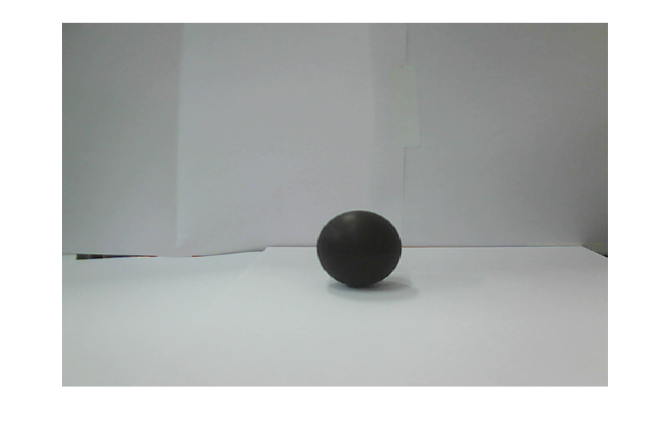
Image Detection
Images can be detected based on only color, only shape or combination of both.
Thresh-holding can be used easily where we have the freedom to chose the environment colors.
For example

Slide 20
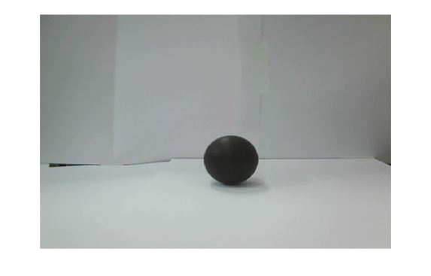
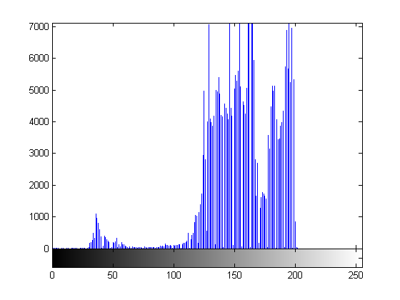
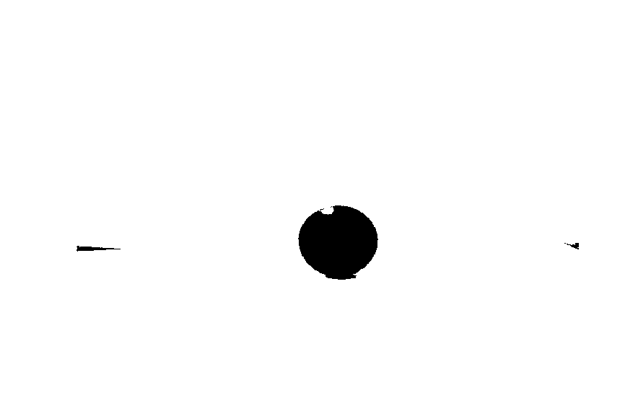
Histogram & thresh-holding
Our ball color is here
imshow(im2bw(bw,0.28));
Code for these three is on next slide

Slide 21
The code
while 1,
trigger(vidobj); % capture one frame
frame= getdata(vidobj); % frame is a matrix that stores the frame, getdata is a inbuilt function that retrieves image from the camera handle
bw = rgb2gray(frame);
imshow(im2bw(bw,0.28)); % 0.28 = x/255
n = n + 1;
if(n>10),% we are capturing total of 10 frames
stop(vidobj); % never forget to close the device handle
break;
end
end

Slide 22
The function reference
http://www.mathworks.com/help/toolbox/images/ref/im2bw.html
Above URL provides detailed list of inbuilt function related to image processing

Slide 23
Limitations
Note that this works because the environment colors are decided by us.
In real world this kind of thing will not work.
This tutorial is limited to this approach only

Slide 24
Location of the object in image
Please read up what is filters and convolution.
We use wiener filter to remove the noise from the filtered image.
Code:
bw = rgb2gray(frame);
bw = im2bw(bw,0.28);
bw = wiener2(bw,[12 12]);
imshow(bw);

Slide 25
The concept of noise
Consider the image
Object
Noise
Noise

Slide 26
Noise Detection
How do we convert into human perception of noise into something that can be detected mathematically ?
One solution: Any pixel which is not similar to it’s neighborhood pixels can be due to noise.
By looking at the neighborhood of the pixel we can make some assumption about a pixel.
Notion of filtering uses this as basis.

Slide 27
Wiener Filter
It’s a noise reduction filter
It’s description is beyond the scope of discussion but you should read up more about
Convolution (signal processing)
http://en.wikipedia.org/wiki/Convolution

Slide 28
Object Detection and labeling
Here we use an inbuilt function to do thresholding and boundary detection and then annotate the detected objects.
The histogram and thresholding techniques can be used by you to tune your environment colors.

Slide 29
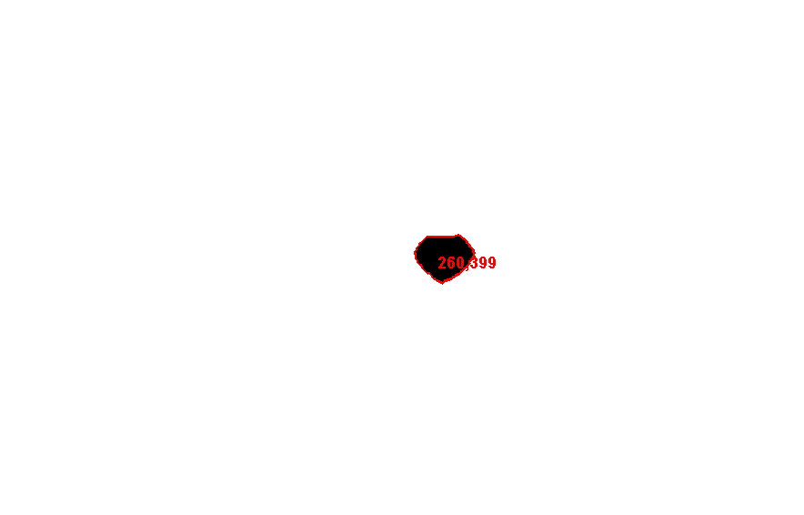

Object Detection and Labelling
Matlab provides a function ‘bwboundaries’ which can be used for detecting boundaries of a binary image.
We provide our filtered noiseless image to this function and it detects the boundaries for us:
Detecting the boundaries and co-ordinates
Original Image

Slide 30
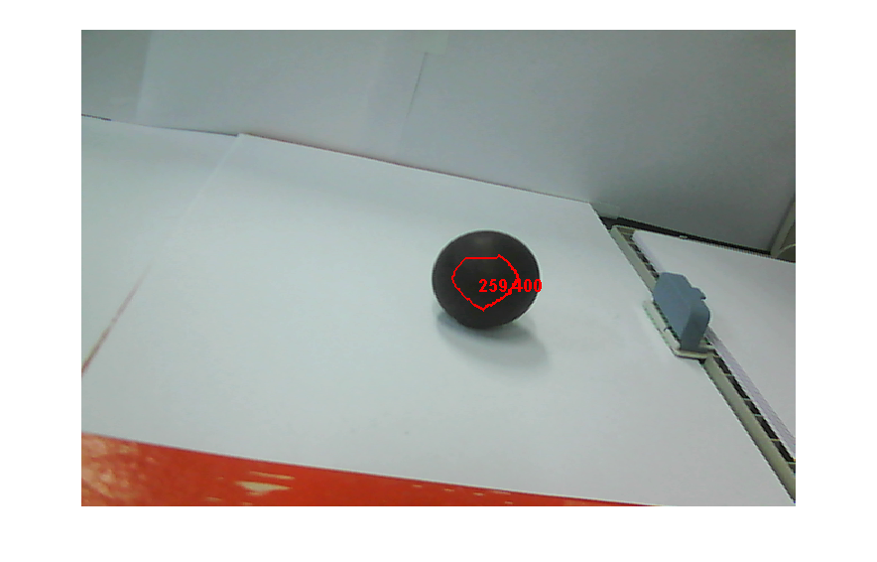
Here is the result of final program

Slide 31
The complete program
The complete program can be downloaded from
https://github.com/akshar100/Matlab-Image-Detection

Slide 32
More on matlab
Matlab provides a large number of inbuilt filters (refer to the function manual)
We can also define our own image filters
We can convert images from one Color model to other.
CMY model is usually very good for color based detection

Slide 33
Two kinds of Object Detection
Color based
Shape based
We have explained only color based detection here.
Shape based detection is more complex.

Slide 34
Controlling Robot
Matlab can issue commands to communicate with the robot using serial communication
Most of us would want the robot to go near the detected object.

Slide 35
Algorithm
Detect the Object in the image
Find the center of the detected object
Try to move the robot such that the center of the object is same as the center of the image

Slide 36
Example Code
if row < 220
'go ahead'
elseif row > 260
'go back'
elseif col>380
'go right'
elseif col<320
'go left'
else
'stop'
end
break;
Row , column is the co-ordinates of the center of the image.

Slide 37
Thank You

